Slide 1


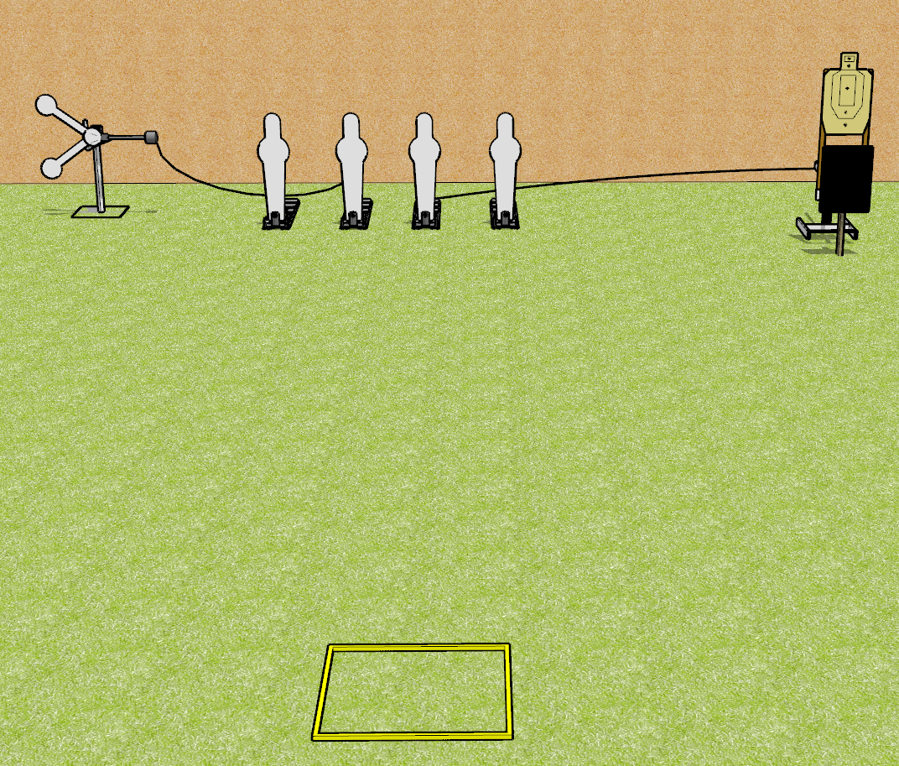
 | Dothan Gun Club – USPSA Match Don’t Ping too Much Course Designer : Drew Coleman
START POSITION : Standing in shooting box, wrists below belt
GUN READY CONDITION : Pistol loaded and holstered. PCC loaded, buttstock on belt, safety on |  | SCORING: Comstock, 8 rounds TARGETS: 1 paper, 6 Steel SCORED HITS: Best 2 on paper, steel until down START-STOP: Audible, last shot RULES:
STAGE PROCEDURE: Engage targets as they become available from within the fault lines.

